Slide 1
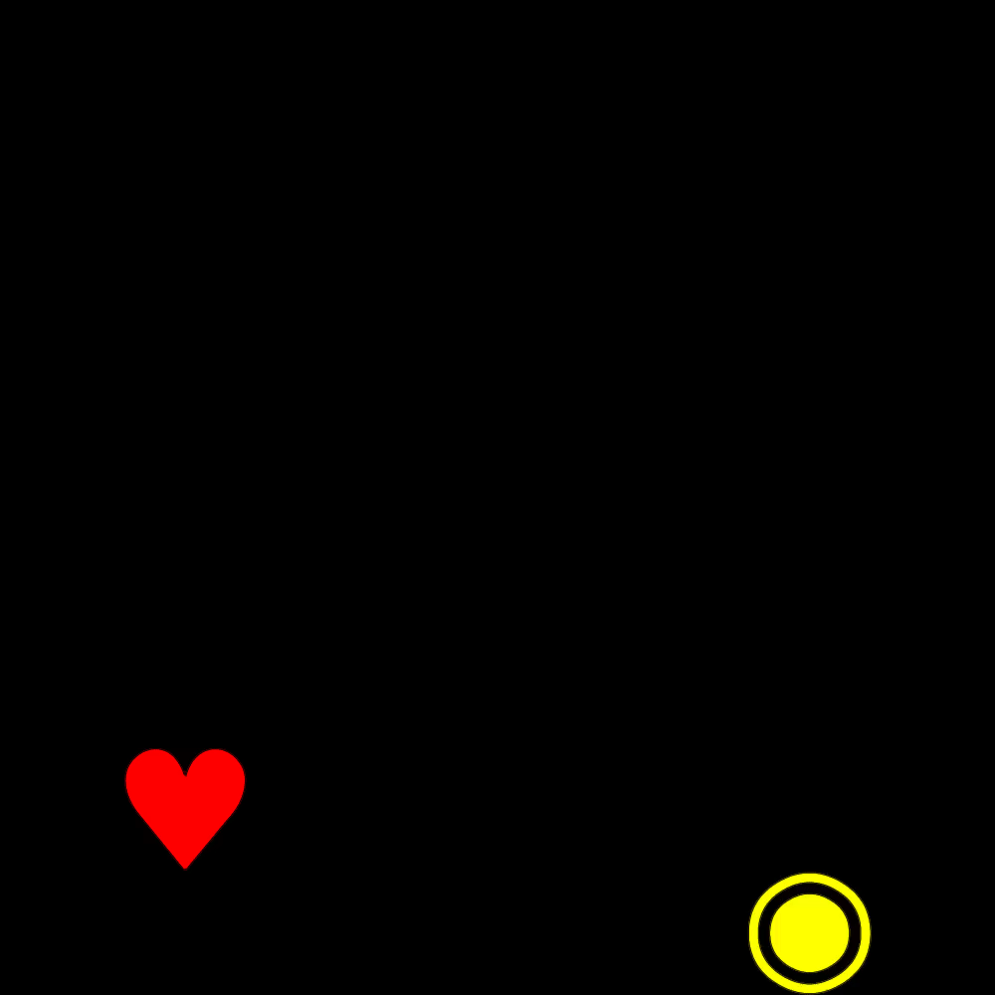

Julia入门基础教程
https://www.bilibili.com/video/BV1pK411T7he

Slide 2
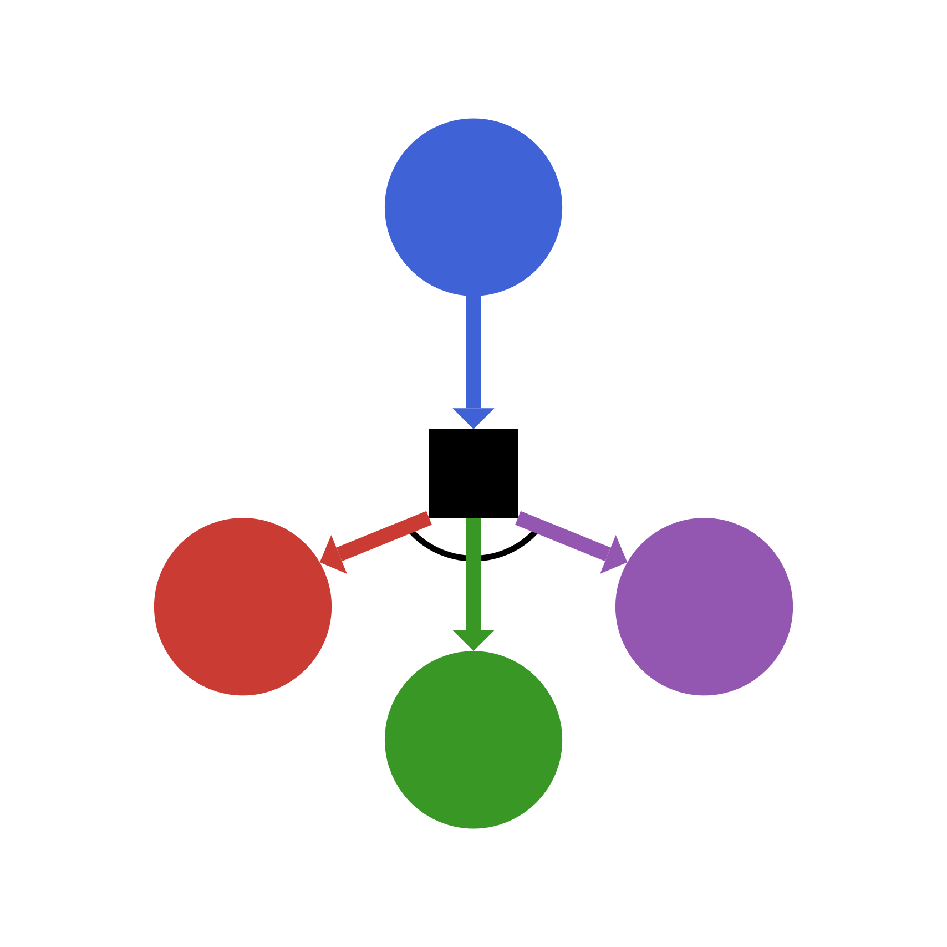
ReinforcementLearning.jl: Design, Implementation, and Thoughts
juliaRL.org
Jun Tian
2020/08/22

Slide 3
Define the problem
Goal

Slide 4
Policy
Environment

Slide 5
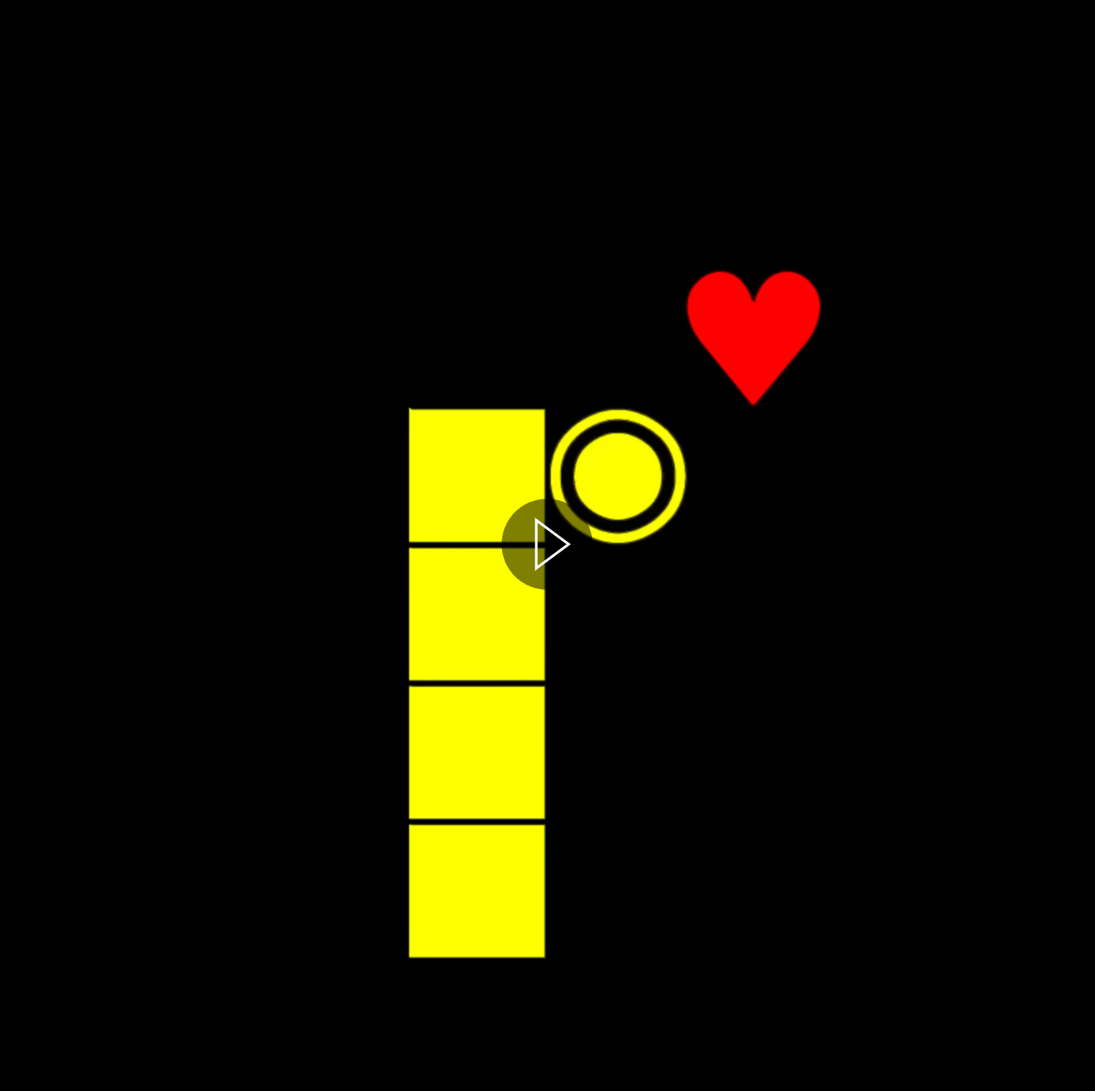
Policy
Environment
Actions
State

Slide 6
Environment
Policy
Single Agent
Minimal Action Set
Full Action Set
Multi-Agent
Two Agent?
Simultaneous?
Perfect Information?
Extended Game Form
...
Q-Learning
Double-Q
Dueling-Q
Rainbow
DQN/IQN/FQN
…
Policy Gradient
A2C/A3C
TRPO/PPO
…
Model-Based
Multi-Agent
…

Slide 7


Slide 8



Stable-baselines
acme
dopamine
Pytorch-DRL
rlpyt
Ray RLLib
TensorLayer
Spinning Up
SLM-Lab
ReAgent
SLM-Lab
TensorForce
ChainerRL
Agents
DeepRL
trfl
tianshou

Slide 9
ReinforcementLearning.jl is
Composable
Extensible
Reproducible

Slide 10
ReinforcementLearning.jl is
HACKABLE

Slide 11

Multiple Dispatch

Slide 12
(env::AbstractEnv) -> action
(policy::AbstractPolicy)(env) -> action
Environment
Policy
Trait Based Design:
NumAgentStyle
DynamicStyle
InformationStyle
ChanceStyle
RewardStyle
UtilityStyle
ActionStyle
Agent
RandomStartPolicy
QBasedPolicy
DQNLearner
NeuralNetworkApproximator
Delegation pattern
Model
StateOverridenEnv
RewardOverridenEnv
ActionScaledEnv
….

Slide 13
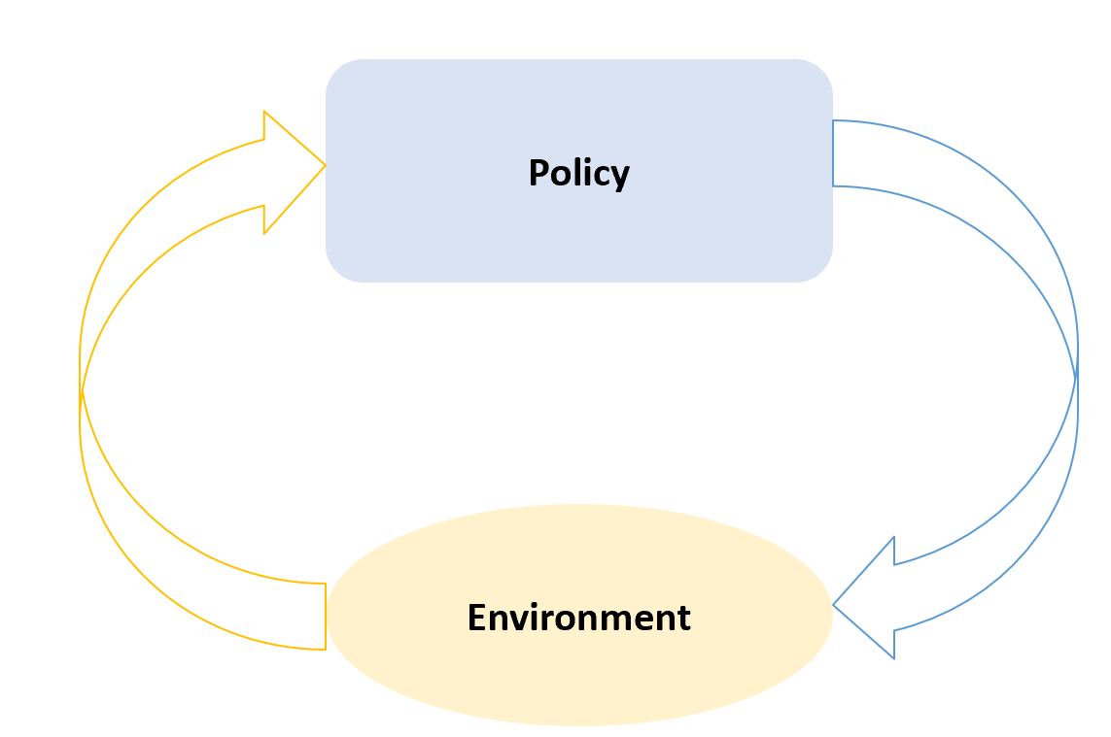
function Base.run(π, env::AbstractEnv)
env |> π |> env
end
function Base.run(π, env::AbstractEnv)
while !get_terminal(env)
env |> π |> env
end
end
function Base.run(π, env::AbstractEnv)
run(π, env::AbstractEnv, DynamicStyle(env))
end
function Base.run(π, env, ::SimultaneousStyle)
# may dispatch to some more specific implementations
end
function Base.run(π, env, ::SequentialStyle)
# may dispatch to some more specific implementations
end

Slide 14
Experiment
PostActStage
Policy
PreEpisodeStage
PostEpisodeStage
PreExperimentStage
PostExperimentStage
Stop Condition
Environment
PreActStage

Slide 15

DEMO

Slide 16

Complains of Existing RL Libraries
The problem with every RL lib I’ve tried is that the designers prioritize brevity-of-use over ease-of-alteration.
Lots of RL libs loooove inheritance, but inheritance sprays state over multiple files and makes adapting things to your own use a real pain. A compositional approach sacrifices something in brevity, but adds a huge amount in flexibility.
Ray RLLIB was also supposed to be high quality implementations. But it hasn’t panned out like that for them yet. It might improve in the future. But trying to make it support tf 1, tf 2 and pytorch has made the code a mess.

Slide 17
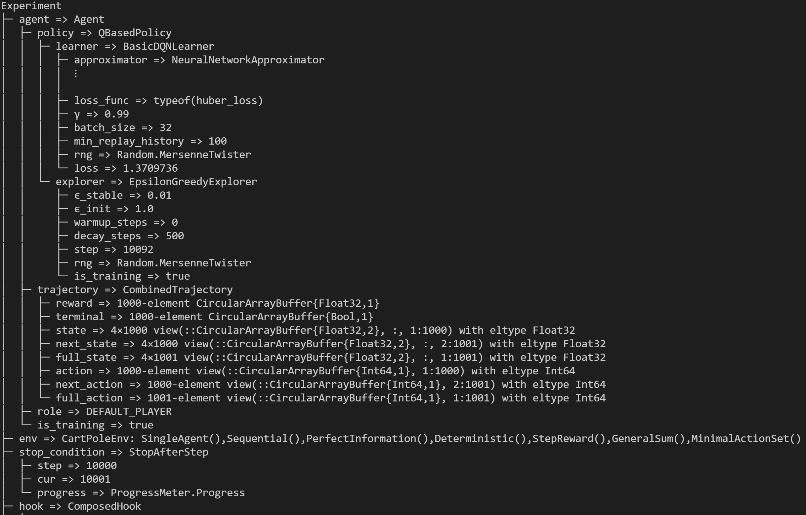
Code as Config

Slide 18
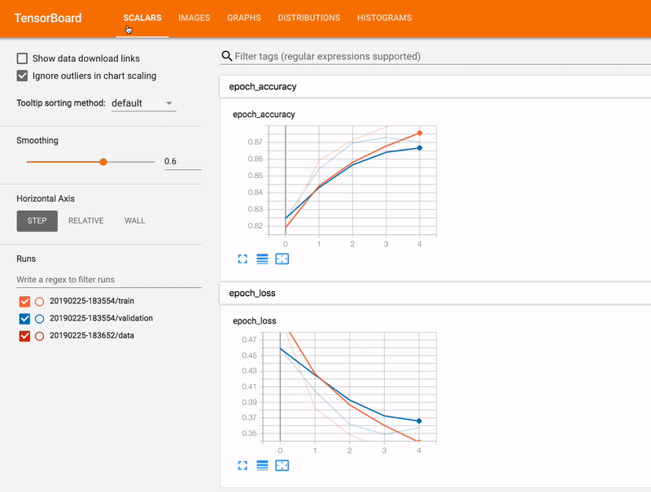
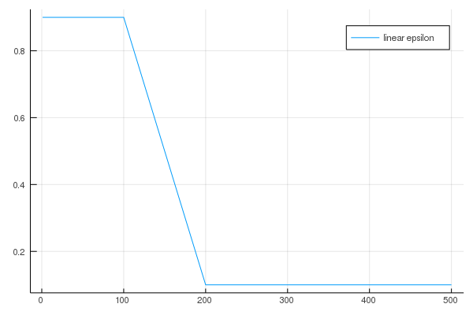

Logging:
AbstractStage
PreActStage
PostActStage
PreEpisodeStage
PostEpisodeStage
PreExperimentStage
PostExperimentStage
Flexible
Hooks
Updating
Learning Rate
Training mode
Testing mode
FastAI’s two-way callbacks
Callback System
https://github.com/deepmind/acme/issues/24

Slide 19

Pluggable
DNN
Knet.jl
Torch.jl
……

Slide 20
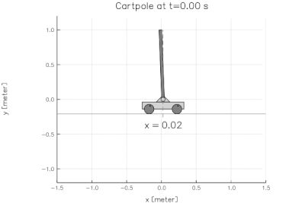
Performance
Experiment | FPS | Notes
E`Dopamine_DQN_Atari(pong)` | ~210 | Use the same config of dqn.gin in google/dopamine
E`Dopamine_Rainbow_Atari(pong)` | ~171 | Use the same config of rainbow.gin in google/dopamine
E`Dopamine_IQN_Atari(pong)` | ~162 | Use the same config of implicit_quantile.gin in google/dopamine
E`rlpyt_A2C_Atari(pong)` | ~768 | Use the same default parameters of A2C in rlpyt with 4 threads
E`rlpyt_PPO_Atari(pong)` | ~711 | Use the same default parameters of PPO in rlpyt with 4 threads
The above data are collected from experiments on Intel® Xeon® W-2123 CPU @ 3.60GHz with a GPU card of RTX 2080ti .

Slide 21
Performance Analysis
Efficient memory usage (CPU)
Trajectory (Experience Replay Buffer)
Multi-threading
Utilize Broadcast in GPU
Some basic understanding of CUDA.jl is necessary

Slide 22
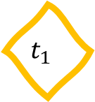
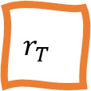
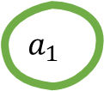
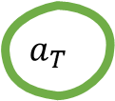
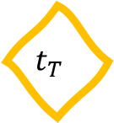
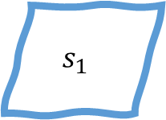



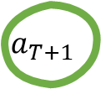
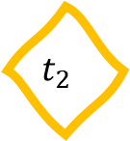

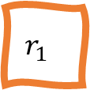
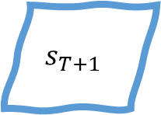
X[:state]
$$s_{1}$$
$$s_{2}$$
$$s_{T}$$
$$s_{T+1}$$
state
X[:next_state]
X[:action]
action
$$a_{1}$$
$$a_{2}$$
$$a_{T}$$
$$a_{T+1}$$
X[:next_action]
reward
$$r_{1}$$
$$r_{2}$$
$$r_{T}$$
X[:reward]
$$t_{1}$$
$$t_{2}$$
$$t_{T}$$
terminal
X[:terminal]
push!(X ;state=$s_{1}$,action=$a_{1}$)
push!(X ;reward=$r_{1}$,terminal=$t_{1}$)
X = CircularCompactSARTSATrajectory(;capacity=T)

Slide 23
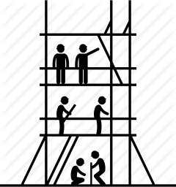
Anti-Framework

Slide 24
Ongoing Work
Multi-agent learning
OpenSpiel
Integrating AlphaZero/MuZero
More environments in Julia
The more the better!
Multi-GPU/Multi-Node
Async DQN can increase 25%
SEED-RL

Slide 25
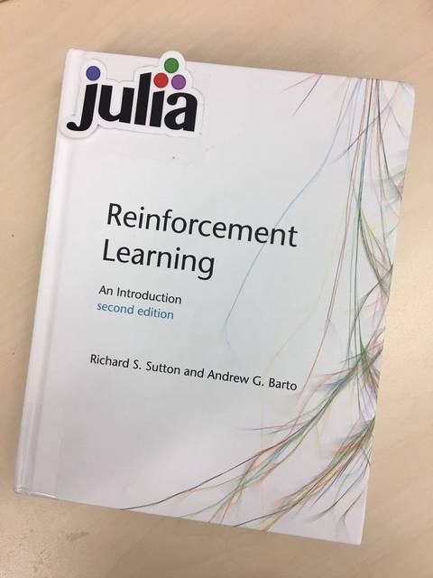
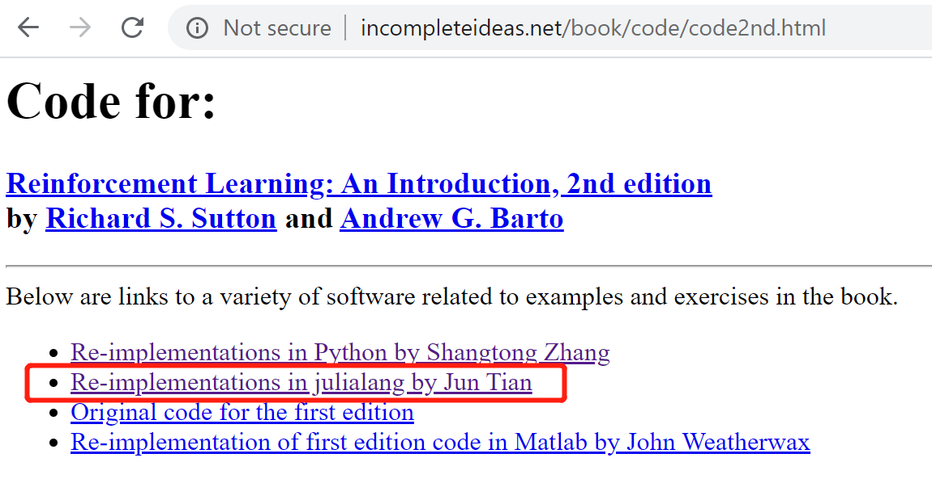
ReinforcementLearningAnIntroduction.jl
How to learn RL in Julia?

Slide 26
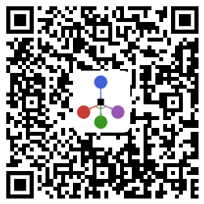
juliarl.org

